Slide 1
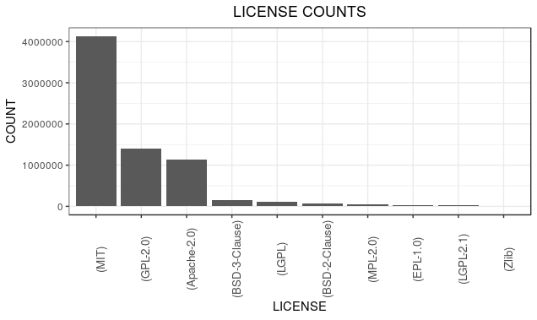

Measuring the universe of
open source software Innovation
Your Name, Graduate Student Name, Post Doc Name, Advisor
Department Listing with captions if needed
Project Introduction
Despite the importance of open source software (OSS) to scientific innovation, there are no commonly used metrics to measure the amount of OSS in existence.
This project aims to measure how much OSS is in use and to better understand the distribution of OSS creation across various sectors in order to evaluate the
economic impact of OSS
Traditional measures of innovation look at the amount of copyright, patents, and trademarks in existence. However, this method does not accurately
capture the universe of OSS innovation. After a data exploration of all of the copyright computer files on copyright.gov, the team determined that only 55 out of ??
files were open source, indicating that standard measurements of innovation do not capture the size and scope of OSS development.
What is Open Source Software?
Licenses
Relevant Sectors
According to the Open Source Initiative, OSS is defined as: "a computer software, with its source code made available with a license, in which the copyright holder provides the rights to study, change, and distribute the software to anyone and for any purpose."
Licenses define the limitations of use for OSS and provide developers with claims when licenses are violated. Holders can choose from various types of licenses.
Government
Business
Non-Profit
Universities
Foreign
Individuals
What is the Open Source Software Universe?
This project defines the OSS universe as all registered open source software.
Tables/findings about OSS
Number of commits (box plot)
Lines of code/project (box plot)
Commits/contributors-double check(box plot)
Number of contributors per project
Projects/year
Contributions/year
Top projects
Graph Description: This graph looks at the top licenses by amount. The MIT license is the most heavily utilized, followed by the General Public License (GPL), and the Apache license.**might need to redo graph
Cost
Method
Total cost: cost per package
Figure #1
Figure #2
Conclusion
Possibly: Networks
References - Franklin Gothic Demi - 24
Modeling the Impact of R Packages Using Dependency and Contributor Networks (Korkmaz et al.)
Social and Decision Analytics Division

